Slide 1
4. Cryptography
朱萍(Ping Zhu)
pzhubupt@gmail.com
School of Science, Beijing University of
Posts and Telecommunications

Slide 2
Cryptography
Cryptography is the science of keeping communications private.
Its goal is to secure communication in the form of a cipher between legitimate users, the sender and the receiver.
  Classical cryptosystems (Symmetric cryptosystems)
  Public-key cryptography (Asymmetric cryptosystems)
  RSA scheme (Rivest, Shamir, & Adleman of MIT in 1977)

Slide 3
4.1 Classical cryptosystems
Terminology
Shift cipher
Affine cipher
Substitution cipher
Vigenère cipher
Pohlig-Hellman Exponentiation Cipher

Slide 4
Terminology
Key
Key
The message or information to be secured is called plaintext.
Encipherment (or encryption) is the process of converting the plaintext into ciphertext.
The process of encryption uses keys, which the legitimate recipient also uses to decipher the ciphertext into the original plaintext.
Sender
plaintext
ciphertext
plaintext
Reciver
Encryption
Decryption
Cryptanalysis
m= D_{K} (c)
c= E_{K} (m)

Slide 5
Terminology (cont.)
Cryptography is the science of securing the ciphertext so as to make it difficult or computationally infeasible for anyone other than the intended recipient to recover the plaintext.
Cryptanalysis is the science of decoding the ciphertext without knowledge of the key.

Slide 6
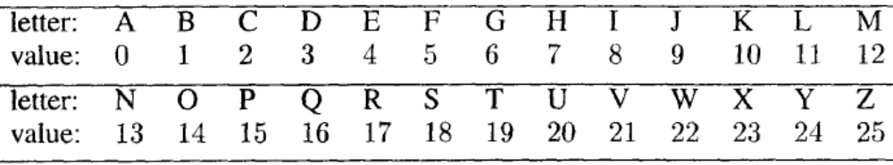
Terminology (cont.)
Secret-key systems vs. public-key systems
In a secret-key system, the sender and the receiver share a key known only to them.
For simplicity, we assume that the plaintext is composed of the 26 letters.
Table of English letters and their numeric values

Slide 7
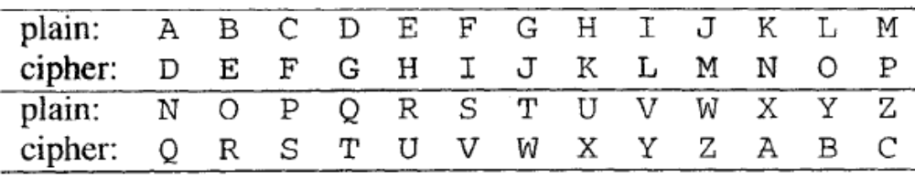
Shift cipher
This is one of the simplest and oldest ciphers. Julius Caesar seems to be the first to have used it.
In its original form, each letter in the plaintext is replaced by a letter 3 steps to the right.
For example, the plaintext retreat at once becomes uhwuhdwdwrqfh.

Slide 8
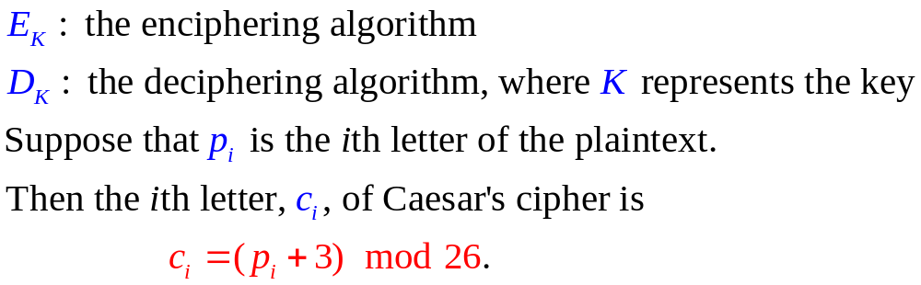
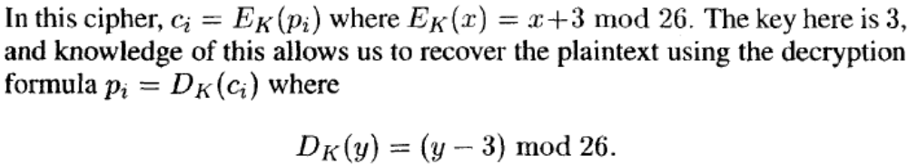
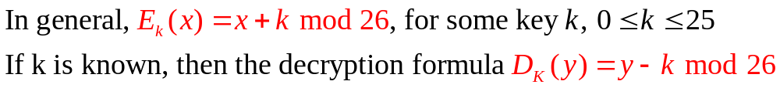
Shift cipher (cont.)

Slide 9
Shift cipher (cont.)
It is not necessary to know the key to recover the plaintext.
  One approach: Since there are only 26 possibilities for k, we can simply try all of them to see which one yields a meaningful plaintext.
  Another approach: use frequency analysis.
e is the most frequently occurring letter in the English alphabet, followed by t , a , o , i , n , s , h , d , r , 1, u.

Slide 10
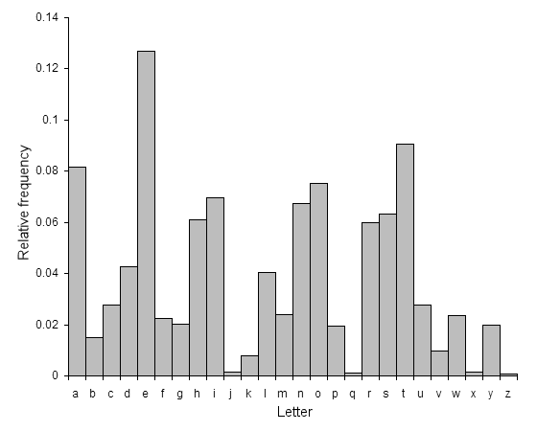
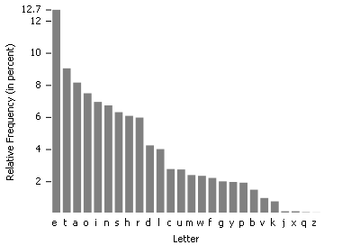
Shift cipher (cont.)
Relative frequencies of letters in the English language:

Slide 11
Shift cipher (cont.)
For example, ciphertext is: cptyqzcupxpyedcpbftcpoezszwoazdtetzy
The two most frequently occurring letters in the cipher are z and p, so it is likely that one of these is e.
  If z represents e, then the key is 25 - 4 = 21. This means that t is represented by o because 19 + 21 = 40 ≡ 14 mod 26. The letter o occurs twice in the cipher, so it is not likely to be t.
  If p represents e, then the key is 11. This means that t is represented by e. Using this key, we readily recover the plaintext (with appropriate punctuation added) to read
  send reinforcements immediately

Slide 12
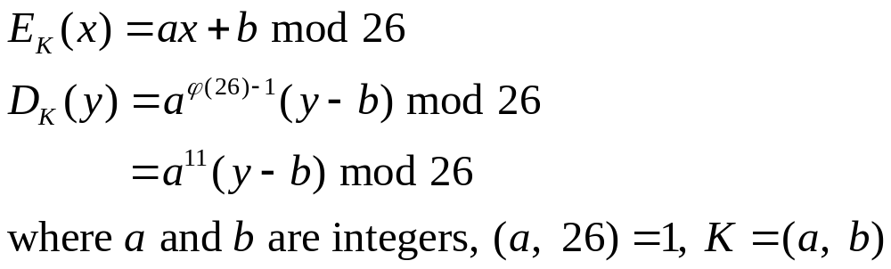
Affine cipher
A simple generalization of the shift cipher.
For example, a = 5 and b = 7. The encryption function is 5x + 7 mod 26.
  To encode: defend the east wall of the castle,
  we have: wbgbuwyqbbhtynhkkzgyqbrhtykb
  Now to decode, the inverse of 5 modulo 26 is 21. The decoding function is 21(y - 7) mod 26, and we get
  defendtheeastwallofthecastle

Slide 13
Affine cipher (cont.)
Cryptanalysis: Affine ciphers can be cracked if any 2 letters are known.
  The number of possible keys is small enough that it is possible to break the cipher by exhaustive search of the keys.
  Frequency analysis
http://www.math.temple.edu/~renault/cryptology/affine.html

Slide 14
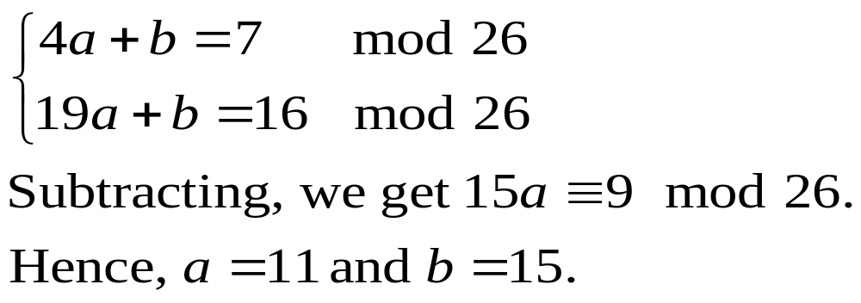
Affine cipher (cont.)
For example, if the 2 most common letters in the ciphertext are h and q, then we assume that these correspond to e and t in English. We can set up (h=7 <--> e=4, q=16 <--> t=19):
If we decrypt the ciphertext under this assumption, we can see if these are correct.
  If they are, that is the end;
  otherwise we could try other combinations of common ciphertext letters as our guess of 'e' and 't'.

Slide 15

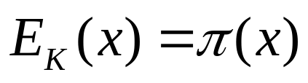
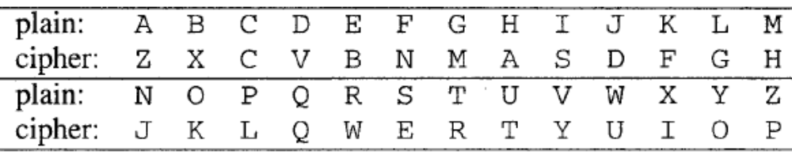
Substitution cipher
A general monoalphabetic substitution scheme in which each letter is replaced by another
In general, we can choose a permutation of the 26 letters and apply it to each letter by the formula
The key, K, in this cryptosystem is the permutation
Consider the permutation:
The plaintext attack now becomes the cipher zrrzcfjku.

Slide 16
Substitution cipher (cont.)
There is a lot of redundancy and other statistical properties of English text, frequency analysis can still be used to cryptanalyze this cipher in spite of the large number (26!) of possible keys.
Natural English text has a very distinct distribution that can be used help crack codes.
Application of the substitution cipher does not change these letter frequncies; it merely jumbles them up a bit.

Slide 17
Substitution cipher (cont.)
To find the key that was used to encrypt the message means finding the mapping for each letter.
For large pieces of text (several hundred leters), it is possible to just replace the most common ciphertext letter with 'e', the second most common ciphertext letter with 't' etc.
  This will result in a very good approximation of the original plaintext, but only for pieces of text with statistical properties close to that for English.

Slide 18
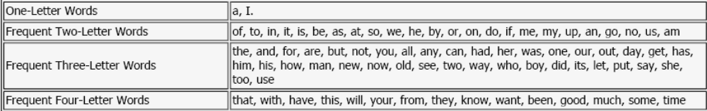
Substitution cipher (cont.)
Short pieces of text often need more expertise to crack.
If the original punctuation exists in the message, e.g. 'giuifg cei iprc tpnn du cei qprcni', then it is possible to use the following rules to guess some of the words, and then, using this information, some of the letters in the cipher alphabet are known.

Slide 19
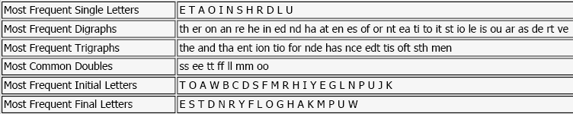
Substitution cipher (cont.)
Usually, punctuation in ciphertext is removed and the ciphertext is put into blocks such as 'giuif gceii prctp nnduc eiqpr cnizz', which prevents the previous tricks from working.
There are, however, many other characteristics of English that can be utilized. The table below lists some other facts that can be used to determine the correct key.

Slide 20
Vigenère cipher
Vigenère Cipher is a polyalphabetic substitution cipher.
The method was originally described by Giovan Battista Bellaso in 1553; however, the scheme was later misattributed to Blaise de Vigenère in the 19th century, and is now widely known as the "Vigenère cipher".
  Vigenère actually invented the stronger Autokey cipher (a key is only used once, after which the message becomes the key) in 1586.
Vigenere Cipher was considered to be unbreakable for 300 years, until in 1863 Friedrich Kasiski published a successful attack.

Slide 21
Vigenère cipher (cont.)
The key is a word or phrase that is repeated as many times as necessary to encipher the plaintext.
It operates on blocks of letters. If the key has length m, then the plaintext is divided into blocks of length m, and the key is added to each block (modulo 26) to produce the cipher.
Suppose the plaintext is i came i saw i conquered and the keyword is egypt; then the ciphertext is produced:
icame isawi conqu ered
egypt egypt egypt egyp
miybx myylb gulfs ixcs

Slide 22
Vigenère cipher (cont.)
The plaintext can be easily recovered if the keyword is known.
But cryptanalysis is more difficult because the frequency distribution is now more uniform.
  For example, the three e's become three different letters.

Slide 23
Vigenère cipher (cont.)
Kasiski's idea is that a letter or a phrase gets encoded to the same value if it repeats at positions that differ by multiples of the key length.
For example, if the key has length 5, and the word the occurs at positions 17 and 42, it results in the same cipher phrase.
Kasiski's technique is to look for repetitions of phrases in the cipher and compute the differences in the position. The key length is a divisor of these differences.

Slide 24
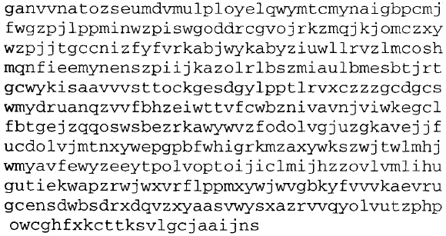
Vigenère cipher (cont.)
As an example, consider the following ciphertext:

Slide 25
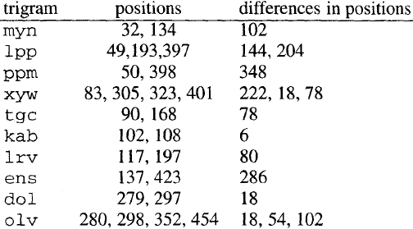
Vigenère cipher (cont.)
Trigrams and their positions in a Vigenère cipher:
6 divides all the numbers in the right hand column except for 80 and 286. So the key may have length 6.

Slide 26
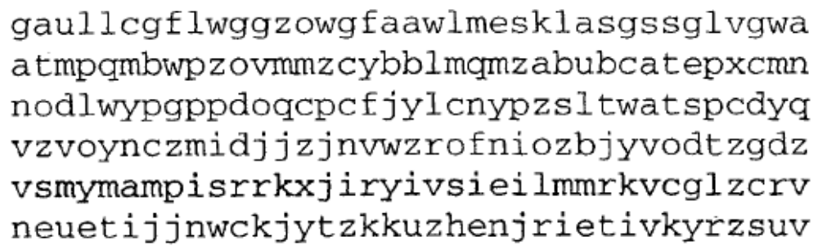
Vigenère cipher (cont.)
Let c be the ciphertext with ci denoting the letter at position i. If the key has length 6, then the string c1 c7 c13 c19 . . . is encrypted by one letter, the first letter in the keyword. This is just the shift cipher, and the shift can be found by frequency analysis. Similarly, c2 c8 c14 c20 . . . is encrypted using the same letter.
Write the cipher in columns with 6 rows, a part of which is:

Slide 27
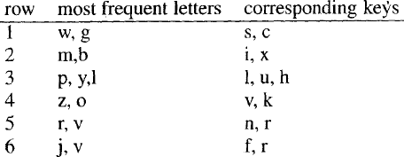
Vigenère cipher (cont.)
The ith row has been encrypted using the ith letter of the key. If a large enough piece of ciphertext is available, we take the most frequently occurring letter to be e.
The two most frequently occurring letters in each row and the corresponding keys when the letters are taken to be e.

Slide 28
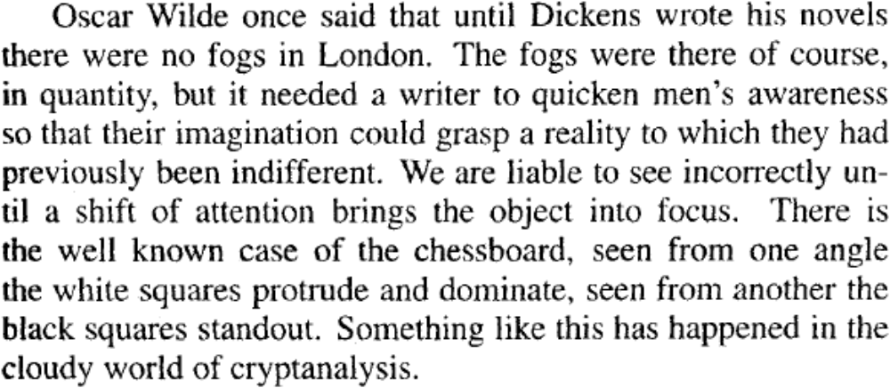
Vigenère cipher (cont.)
Now it is possible to try combinations of these letters to see that the word silver decrypts the cipher into the plaintext:

Slide 29
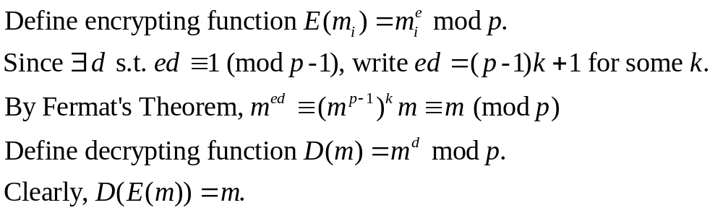
Pohlig-Hellman exponentiation cipher
It is a simple exponentiation cipher, invented by Pohlig and Hellman in 1976.
  p: an odd prime
  m: the numeric equivalent (2 digits for every letter) of the plaintext
  Subdivide m into blocks mi s.t. 0<mi<p.
  e: an integer, 0<e<p, (e,p-1)=1

Slide 30
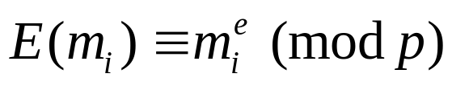
Pohlig-Hellman exponentiation cipher
Example. Choose p = 4578971 and e = 3317271 so that (e, p-1)= 1.
We compute the inverse of e modulo p-1, d = 573651.
Suppose our message text is BEGIN ATTACK; this is converted to m = 010406081300191900021020.
We break the message into blocks mi so that 0 < mi < p, where mi is a large as possible. As p has 7 digits, we divide m into blocks of 6 digits each, i.e.
m = 010406 081300 191900 021020.
We compute to obtain the cipher
4137884 0438421 3227477 233970.

